Slide 1
Robot manufactures
Stefan, Sven & Thijs

Slide 2
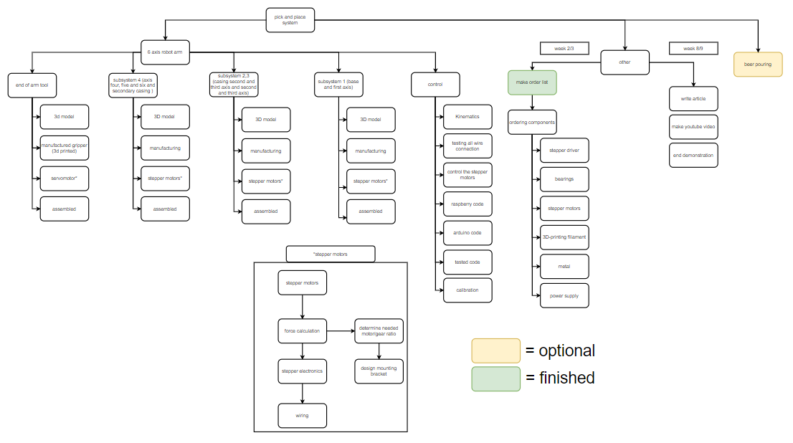
What did we do this week?
Start with 3D model
Made a PBS

Slide 3
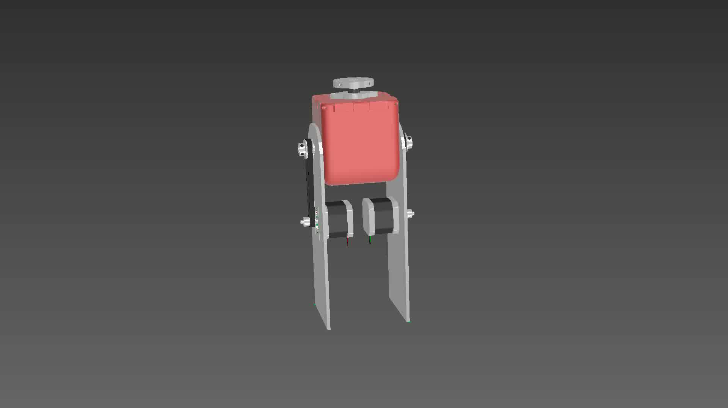
Differential gear

Slide 4
Base and gripper
Design in Inventor
Aluminum parts
3D filament parts

Slide 5
Planning next week
Continue with 3d model
Make the parts
Assemble the parts
Start with wiring all components
Test all electric components

Slide 6
Questions

